Slide 1
webFCM-javascript
Reference official website
https://firebase.google.com/docs/cloud-messaging/js/client

Slide 2
FCM
Firebase cloud Message

Slide 3
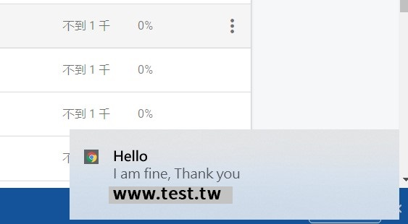
WEB API
Notification API – to display notifications
Push API -- to handle message
Browser Support
https://caniuse.com/

Slide 4
 | Chrome(88) | Chrome for Android(84) | Safari (14-TP) | iOS Safari(14.0)
ServiceWorker | V | V | V | V
websocket | V | V | V | V
Push API | V | V | X | X
Notification | V | V | V | X

Slide 5
Work Flow
7:53
https://www.youtube.com/watch?v=ggUY0Q4f5ok#t=7m53s

Slide 6
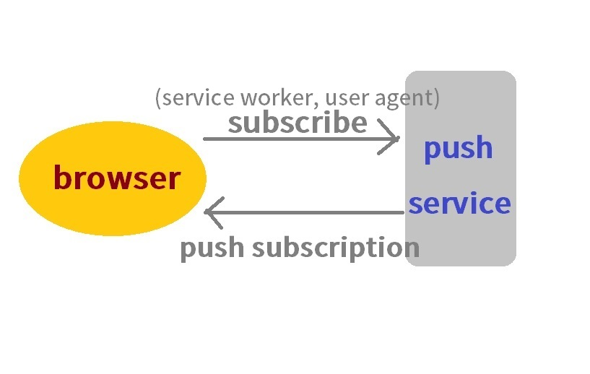
FCM Work flow

Slide 7
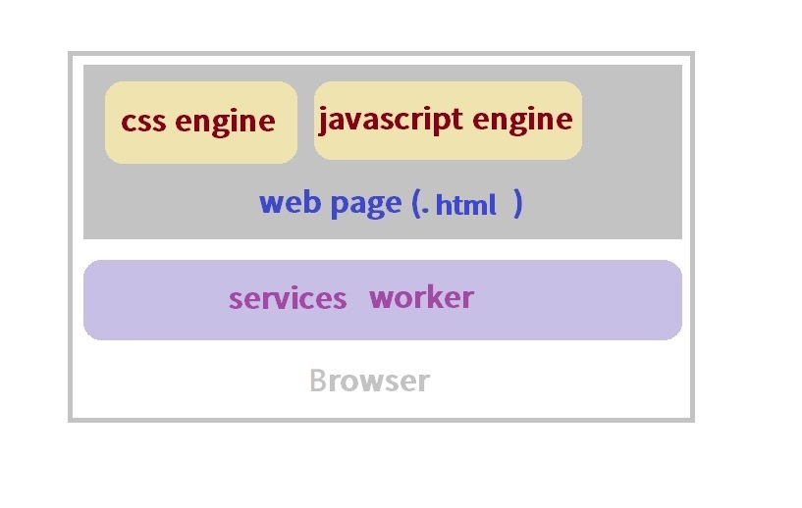
Service worker

Slide 8
Step
1.Get Source Code
2.unzip
3.change usePublicVapidKey and app init
send message
4.ajax
5.firebase console

Slide 9
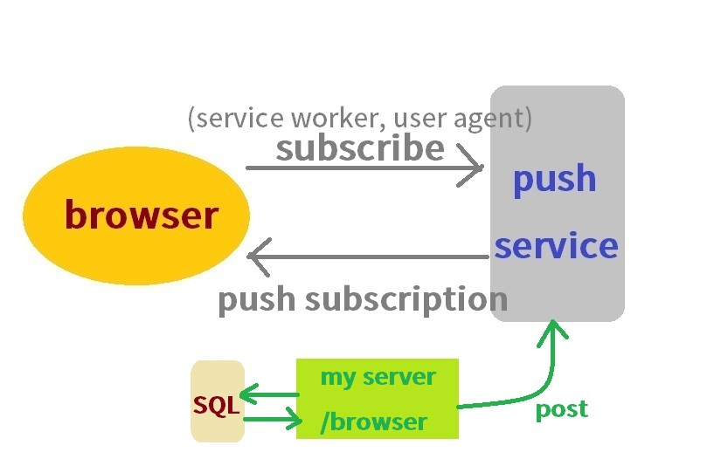
browser/backend post to push service

Slide 10
description
onMessage
setBackgroundMessageHandler
https://firebase.google.com/docs/cloud-messaging/js/receive

Slide 11
Click open url
We find it go to the website index
after click notification.

Slide 12
Click open url
“click_action” in “data” tag,
not in “notification” tag. -->Q1

Slide 13
Received message construct
Received message:
{
"data": {
"gcm.n.e": "1",
"google.c.a.ts": "1599671655",
"google.c.a.udt": "0",
"google.c.a.e": "1",
"google.c.a.c_id": "9148247952546463567",
"click_action": "https://www.google.com",
"google.c.a.c_l": "uTest",
"gcm.notification.mutable_content": "true"
},
"from": "1036640110517",
"priority": "high",
"notification": {
"title": "How are you",
"body": "I'm fine, Thank you",
"tag": "campaign_collapse_key_9148247952546463567"
},
"collapse_key": "campaign_collapse_key_9148247952546463567"
}

Slide 14
Q1.click_action
When you click notification, open a window Url
→ change firebase-messaging.js
(not suggest XD, because it is my bad idea)

Slide 15
Q2:Not working
Q:
SetBackgroundMessageHandler
never fired
A:
https://github.com/firebase/quickstart-js/issues/71

Slide 16
Q3:initApp
http://localhost:8081/__/firebase/init.js

Slide 17
Delete Service worker
chrome://serviceworker-internals/

Slide 18
The Other Way
Websocket + ServiceWorker + Notification

Slide 19
Odp file
My vedio file in github
Github url
https://github.com/orangecatmiao/vedio_file

